Slide 1
GENERATOR DESIGN: BENTHIC MICROBIAL FUEL CELLS for Long term Sensors Networks
Brandon Kelly
Mentored by dr. Jordon Beckler
FAU reu for renewable energy
6/23/2022

Slide 2
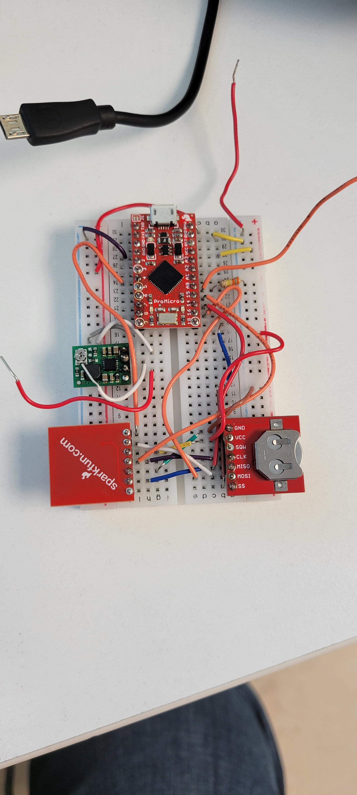
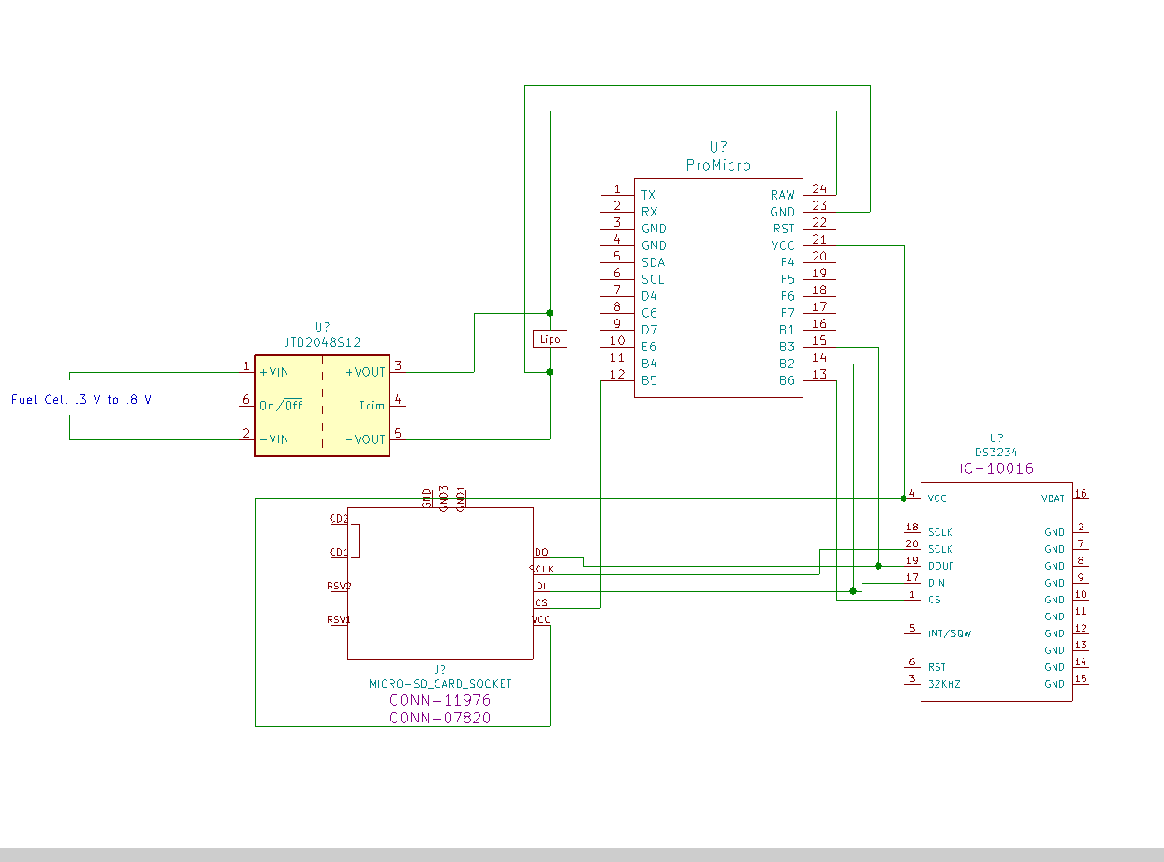
Wiring the sensor

Slide 3
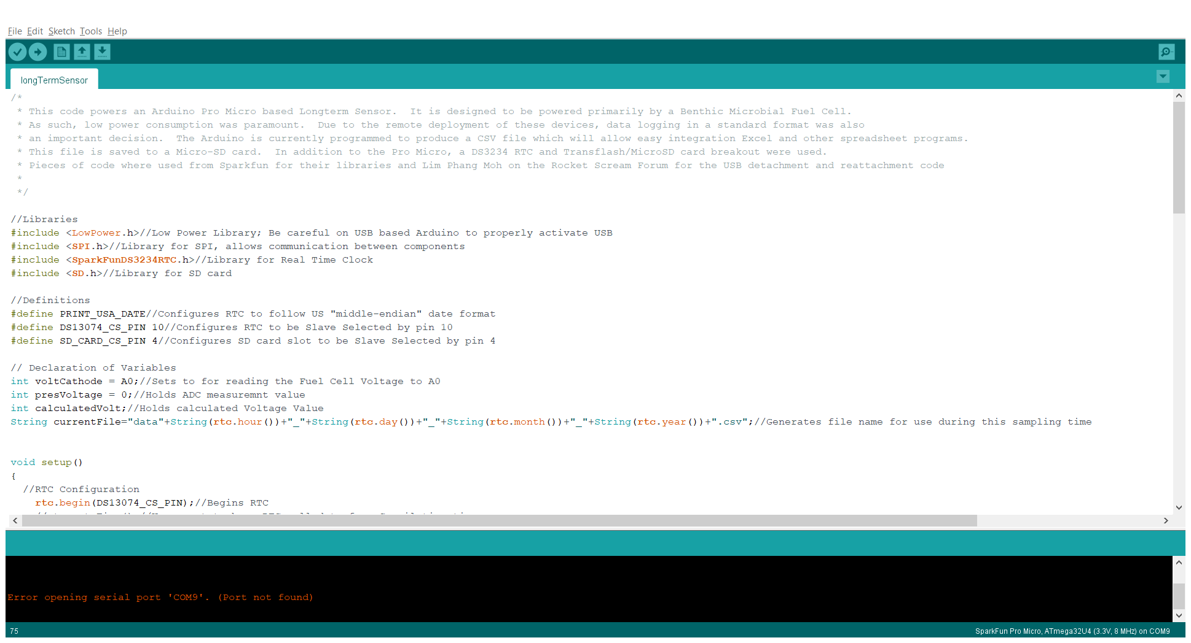
Coding the sensor
Completed Goals:
Monitor Voltage
Record and Timestamp Data
Enter Sleep Mode After Logging
To Be Done:
Change Wake Signal to be Interrupt Driven
Reduce Number of Cycles Needed, i.e. Optimize Code

Slide 4
Prepping the potentiostat
Prepare Gold Working Electrode
Polish 100 μm Wire
Plate with Mercury Amalgam
Prepare Silver Counter Electrode
Oxidize Silver Probe in Chloride Solution (KCl)
Form AgCl
Platinum Reference Electorde
Notes:
Keep it brief. Focusing on Caps as storage not for other properties

Slide 5
Goals for next week
Conduct Measurement of Polarization Curve
Prepare Fuel Cells for Testing at the End of the Summer
Research Enclosure

